Slide 1
BIG DATA PROJECT
VisionServe Alliance &
The Ohio State University
John E. Crews, DPA
July 20, 2022

Slide 2
What is the Big Data Project?
Stand alone state reports estimating the prevalence of blindness and low vison at the state and county level among people age ≥65 years.
Stand alone state reports that describe social, economic, health, and quality of life factors among people who are blind and have low vision aged ≥65 years compared to older people without blindness and low vision at the state level.

Slide 3
Why the Big Data Project?

Slide 4
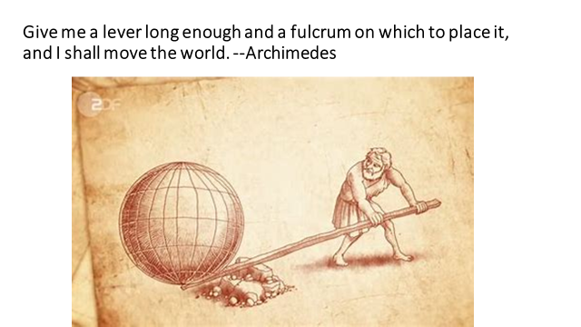

Slide 5
Data to Support Advocacy
Successful advocacy activities tell a compelling story
Data regarding the prevalence of blindness and low vision among older people is part of the story
Data regarding their circumstances are another part of the story
Data that are rigorous, comprehensive, and gathered consistently across the nation provide credibility
Data provide evidence to support coalition agenda
Stories of the human experience of blindness and low vision

Slide 6
Who has the data
has the power.
            --Tim O’Reilly

Slide 7
Details, Details

Slide 8
Aim of Big Data Project
1. Provide state level data on prevalence of blindness and low vision among people aged 65 years and over
2. Provide county level estimates of the prevalence of blindness and low vision in each state

Slide 9
Aim of Big Data Project
Provide state level data on people with and without blindness and low vision on:
3. Health
4. Chronic Conditions
5. Health Related Quality of Life
6. Disability Measures
7. Income and Poverty
8. Education

Slide 10
Big Data Briefing Organization
Promised 6-8 Page Reports; Delivering 30+ Page Reports
Executive Summary: 1 ½ Page
Context: National level perspective & discussion of vision rehab services: 3 ½ pages
State Level Prevalence
State map showing county level distribution
Chronic Conditions, Health Related Quality of Life, & Disability Measures: 5 pages
Tables: State & county level prevalence; 60 BRFSS variables comparing people with and w/o blindness and low vision.

Slide 11
Data Examined
Behavioral Risk Factor Surveillance System (BRFSS). Administered by states, financial support and protocol from CDC.
Samples 440,000 people annually. World’s largest and oldest phone survey; Complex sampling frame; Post survey weighting
Addresses health behaviors (smoking) and risks (obesity). Used to inform health policy
Provides state (and regional) and aggregated national data annually.
American Community Survey. Administered by Census. Five year aggregated data provides county level information

Slide 12
Case Definition of blindness and low vision:
“Are you blind or do you have serious difficulty seeing, even when wearing glasses?”
Both BRFSS and ACS ask the same vision question
Response is yes/no; no scaled response
Neither survey asks about vision rehabilitation
Every survey has limitations

Slide 13
Completed Nine Reports
National Report
Pennsylvania
Illinois
Missouri
New York
California
Louisiana
Florida
Oklahoma

Slide 14
Findings
National prevalence of blindness and low vision in response to the question “Are you blind or do you have serious difficulty seeing, even when wearing glasses?” is 7.3%.

Slide 15
But we know. . .
Women are more likely than men to report blindness and low vision.
    Women: 7.5%
    Men: 7.0
Older age groups are more likely to report vision problems
    Ages 65-74: 6.3%
    Ages 75-79: 7.4%
        Ages 80+: 9.8%

Slide 16
Blindness and Low Vision Vary by Race Ethnicity
    White: 6.1%
    Asian: 8.8%
    Black: 10.5%
    Hispanic: 13.9%
    Native American: 14.2%

Slide 17
Is Blindness and Low Vision Evenly Distributed across the United States?

Slide 18
Big Data Findings: Prevalence
State Level Variability
US Average = 7.3%
Lowest = 5.8% Illinois
Highest= ????

Slide 19
Big Data Findings: Prevalence
US Average = 7.3%
Lowest = 5.8% Illinois
Highest = 12.4% Louisiana

Slide 20
Prevalence of Vision Impairment among People with and without Vision Impairment, Age 65+, US and 8 States

Slide 21
Is Blindness and Low Vision Evenly Distributed within States?

Slide 22
County Level Variability
Missouri as Example:
Overall Prevalence of Blindness and Low Vision among people age 65+ is 7.6%
County with lowest prevalence: Osage County—2.6%
County with the highest prevalence: ??????

Slide 23
County Level Variability
Missouri as Example:
Overall Prevalence of Blindness and Low Vision among people age 65+ is 7.6%
County with lowest prevalence: Osage County—2.6%
County with the highest prevalence: Pemiscot —21.1%

Slide 24
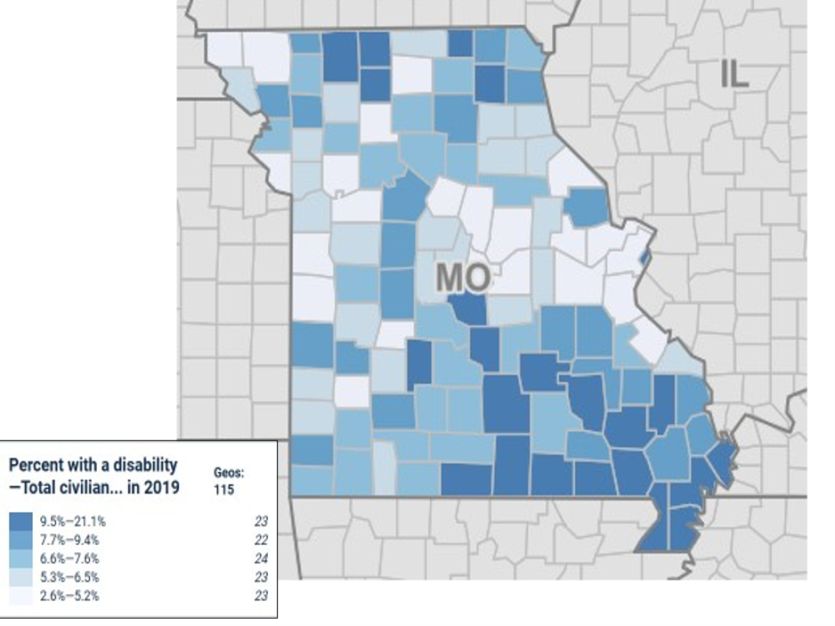

Slide 25
Knowing Prevalence is Not Enough!

Slide 26
Disparities
Disparities in health, chronic conditions, QoL, disability status, and income define serious disadvantage for most older people with Blindness and Low Vision

Slide 27
Chronic Conditions among People Age ≥65 Years with and without Blindness and Low Vision, United States, BRFSS, 2019

Slide 28
Stroke among People with and without Vision Impairment, Age 65+, BRFSS, US and 8 States

Slide 29
Diabetes among People with and without Vision Impairment, Age 65+, BRFSS, US and 8 States

Slide 30
Depression among People with and without Vision Impairment, Age 65+, BRFSS, US and 8 States

Slide 31
Serious Difficulty Hearing among People with and without Vision Impairment, Age 65+, BRFSS, US and 8 States

Slide 32
Disparities in Health Related Quality of Life

Slide 33
Health Related Quality of Life: BRFSS, 2019, US

Slide 34
Disparities in Disability Measures

Slide 35
Disability Measures: US, BRFSS, 2019

Slide 36
Could Not Get Care Because of Cost among People with and without Vision Impairment, Age 65+, US and 8 States

Slide 37
Annual Income less than $20,000 among People with and without Vision Impairment, Age 65+, US and 8 States

Slide 38
BIG DATA Contributions
State Specific data from the BRFSS and ACS
Only study to examine health, chronic conditions, health-related quality of life, and disability measures among older people who are blind and have low vision at the state level
Only study to provide county level estimates of blindness and low vision for older people
Recent --2019—data from BRFSS & ACS
Only study where all this material resides in the same document.

Slide 39
BIG DATA Contributions
Demonstrates that many older people with blindness and low vision are often disadvantaged in multiple ways
Knowledge is lever for advocacy

Slide 40
Without data, you’re just another person with an opinion.
      --W. Edwards Deming

Slide 41
So what?
Chance favors the well-prepared mind.
― Louis Pasteur

Slide 42
Foundation
Big Data Project serves as a foundation
Informs strategic planning
Drives policy development
Engages stake holders—aging, public health
Other materials will fill gap between state data and human experience.

Slide 43
Action Steps
Compile stories of effectiveness of vision rehab
Develop strategic plan showing what can be done
Share with state Management and Budget
Share with Aging
Share with Public Health—using their data
Use Briefing for media
Use portions of Briefing for grant applications

Slide 44
Fill in the gap.
Numbers have an important story to tell. They rely on you to give them a clear and convincing voice.
--Stephen Few

Slide 45
Thank You!

Slide 46
Thank You Very Much!

Slide 47
Contact information:
John E. Crews, DPA
johncrews@bellsouth.net

Slide 48
“The inability to detect and monitor prevalence and trends in the impact of vision impairment and blindness across the United States makes it difficult to characterize the burden of poor eye health among population groups and geographic locations and to then recommend specific effective interventions.”
--National Academies of Science Engineering and Medicine, 2016

Slide 49
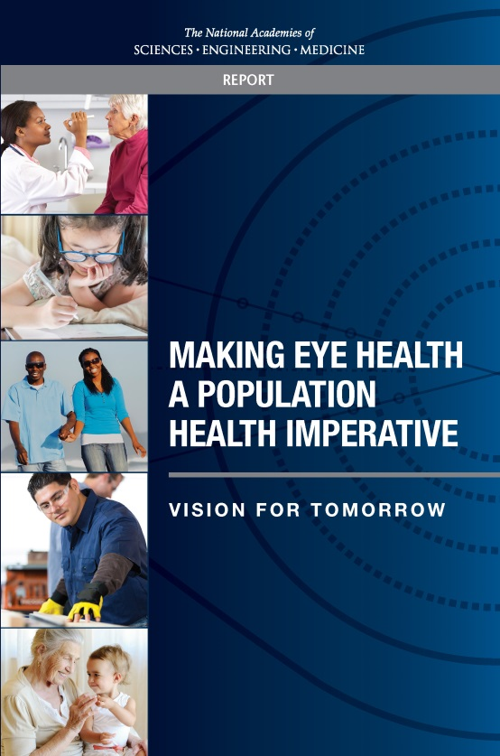

Research
The NASEM Report
Recommendation 3
  Identifying and validating surveillance and quality-of-care measures to characterize vision-related outcomes, resources, and capacities within different communities and populations
  Analyzing, interpreting, and disseminating information to the public in a timely and transparent manner

